Slide 1
Who Has Back Pain?
Thomas R. Shaw M.D.
Board Certified in Physical Medicine & Rehabilitation
MJF Rehabilitation, PA
Peterson Outpatient Rehabilitation Medical Director
Adjunct Clinical Faculty, University of the Incarnate Word School of Medicine

Slide 2
Overview
How Common is It?
Causes?
What can I do?
When should I see my doctor?
What can he or she do?
Questions

Slide 3
Is it Common?
>85% of people will experience during lifetime
A top 10 reason for a visit to a doctor
Vast majority of cases self-limited
Small percentage will have ongoing, chronic issues

Slide 4
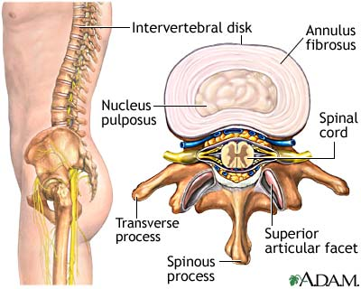
Causes
Muscles
Joints
Discs
Nerves
Bones

Slide 5
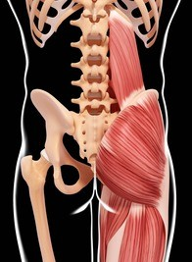
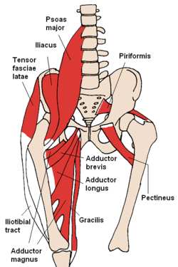
Muscles

Slide 6
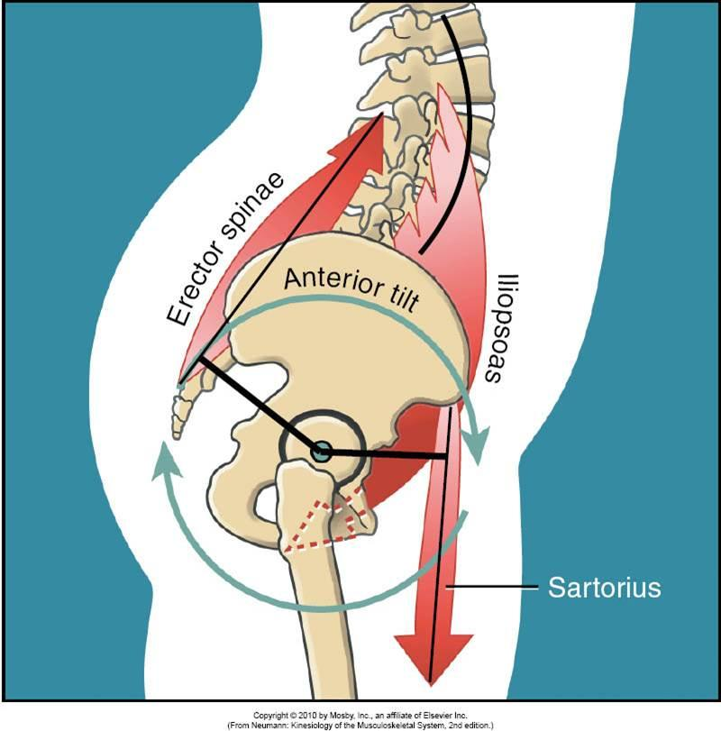
Muscles

Slide 7
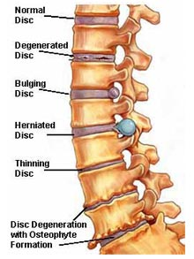
Intervertebral Discs
Jelly Donuts
Dehydrate over time
Bend, Twist, and Lift

Slide 8
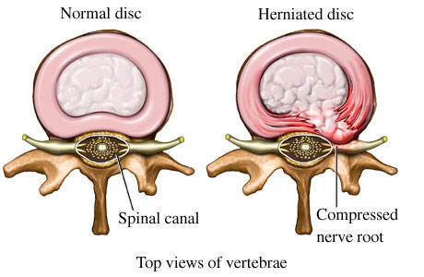
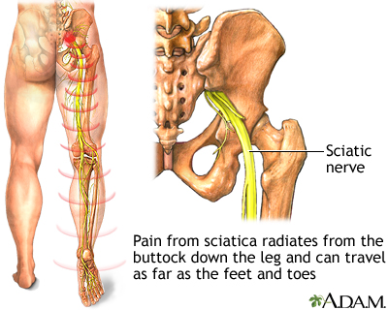
Discs
Nerve Compression
“Sciatica”

Slide 9
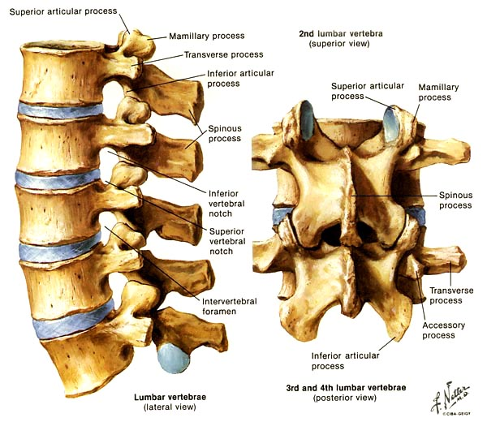
Joints

Slide 10
Joints….again
Squished Jelly Donut
More force through the joints
Arthritis
Narrowing aka “Stenosis”

Slide 11
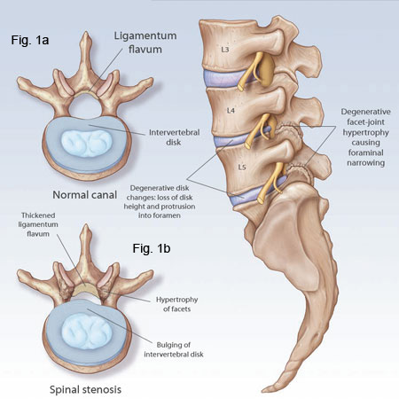
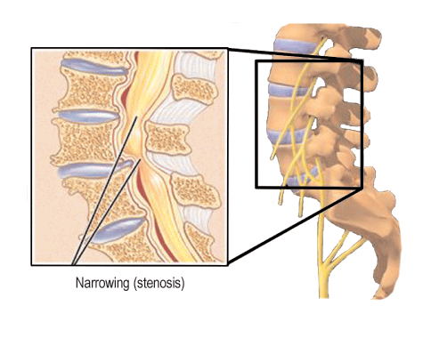
Nerves and Stenosis

Slide 12
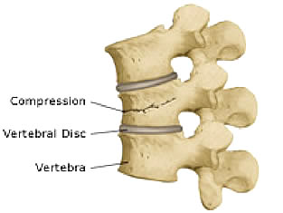
Bones
Compression Fracture
Kyphosis

Slide 13
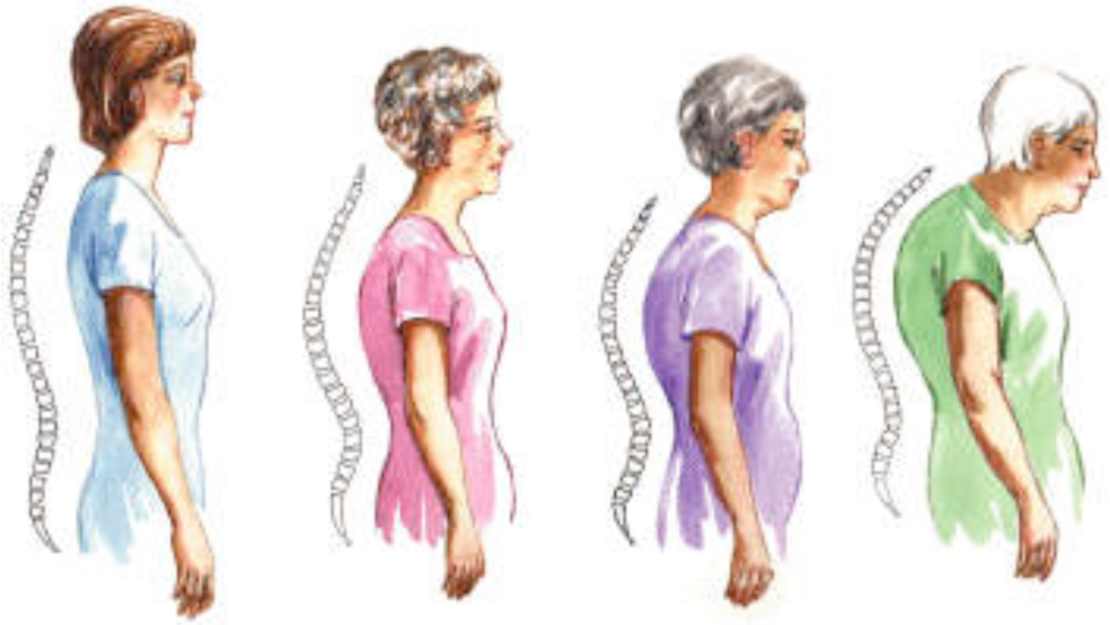
Bones
Compression Fracture
Kyphosis
Worsening of muscle imbalance

Slide 14
It’s All Connected
Muscles:Joints:Discs:Nerves:Bones
Each structure impacts the others
Back pain is never simply one problem

Slide 15
What Can I Do?
Stay Active
Flexibility
Strengthening
Self Treatments

Slide 16
Stay Active
Prior studies: Bedrest worsens pain
Endorphins
Improves Sleep
Improves Mood
Aquatics

Slide 17
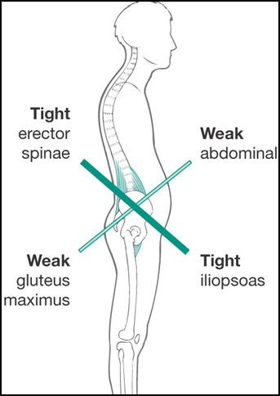
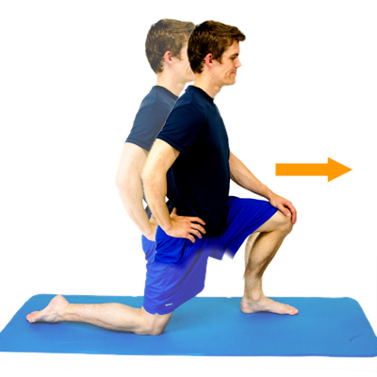
Flexibility: Correct Muscle Imbalances
Hip Flexor
While kneeling, lean forward and bend your front knee until a stretch is felt along the front of the other hip.

Slide 18
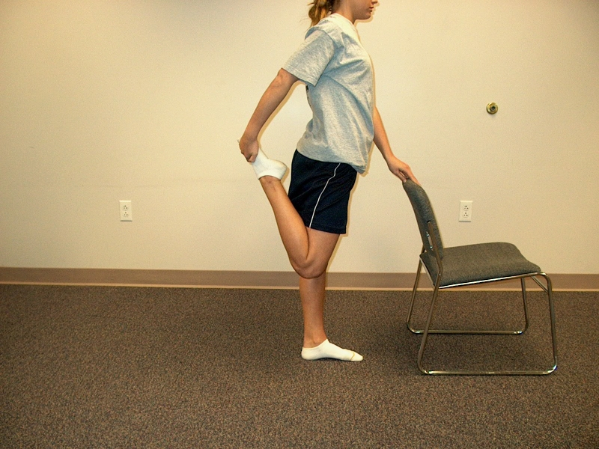
Flexibility: Correct Muscle Imbalances
Knee Extensor
Pull heel toward buttock until stretch is felt in front of thigh.

Slide 19
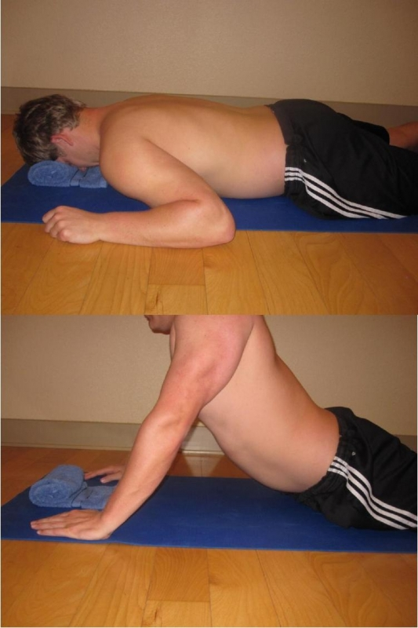
Flexibility: Correct Muscle Imbalances
Front Complex
Lie flat on your stomach, with towel roll under your forehead (for ease of breathing), and place both arms out to the side, near shoulder height. Slowly raise yourself up onto your hands at a comfortable angle, and hold for desired length of time. Slowly lower yourself back to the mat, relax, and repeat as indicated.

Slide 20
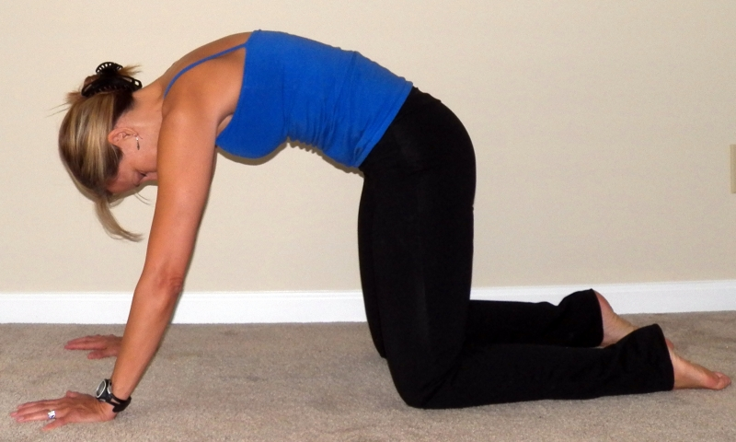
Flexibility: Correct Muscle Imbalances
Back Extensor
On hands and knees with your hands placed shoulder width apart and knees under your hips, as you exhale, slowly round the spine, pulling the belly button towards the spine. Emphasize stretching the low back area with less rounding of the upper back to create symmetry in the reversal of the spinal curves. As you inhale return to a neutral spine

Slide 21
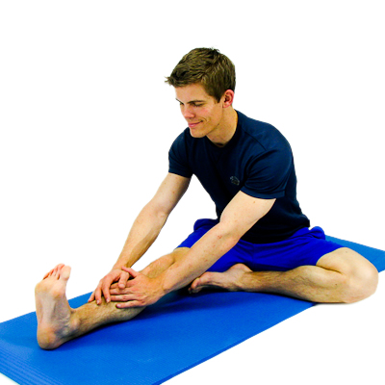
Flexibility: Correct Muscle Imbalances
Knee Flexor
While sitting with your leg stretched out, reach forward with your hands towards touching your toes.

Slide 22
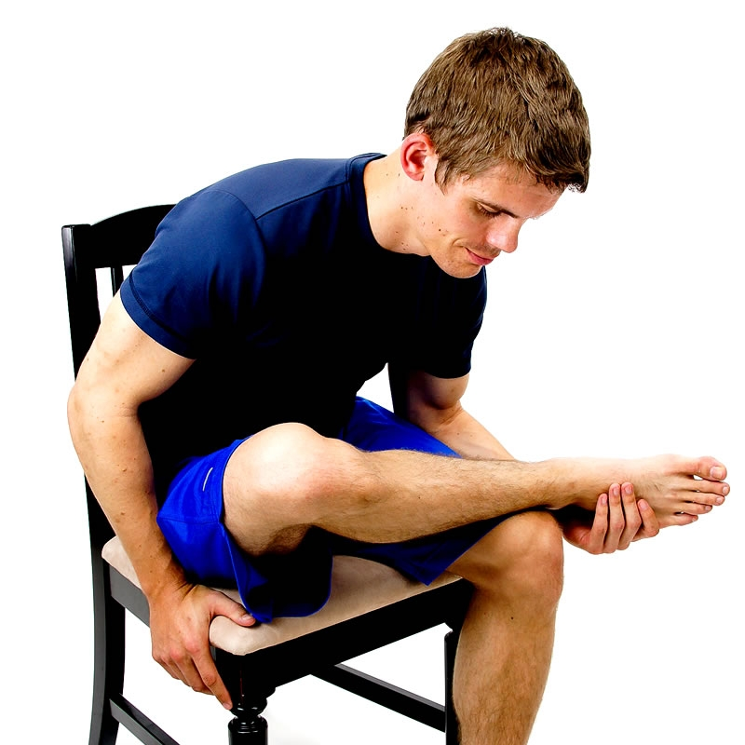
Flexibility: Correct Muscle Imbalances
Glute/Piriformis
While sitting in a chair, cross your affected leg on top of the other as shown.
Next, gently lean forward until a stretch is felt along the crossed leg.

Slide 23
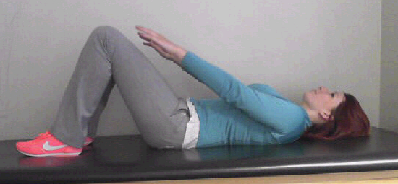
Strengthening: Correct Muscle Imbalances
Abdominals
Lie with knees bent and feet flat on the ground. Extend arms in front of you towards the knees, and when you crunch you abs, move hands closer to knees.

Slide 24
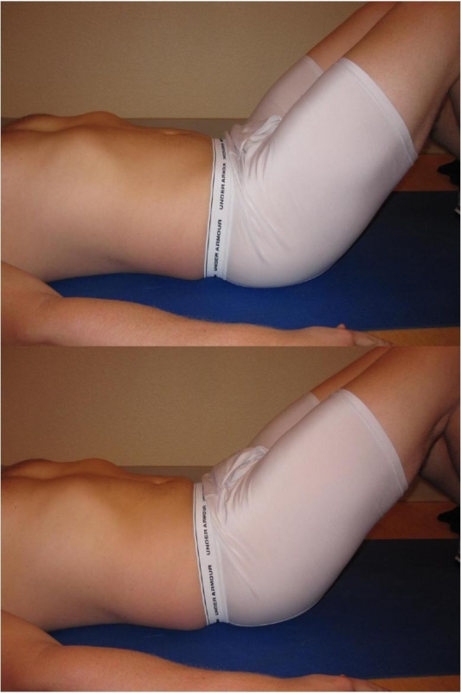
Strengthening: Correct Muscle Imbalances
Posterior Pelvic Tilt
Sink the belly button, contracting your core musculature. While maintaining contraction, scoop hips up, while flattening your lower back on the mat. Hips should maintain contact with mat at all times. Hold 5 seconds, relax the hips, then the core musculature. The core should be the first thing on and the last thing off.

Slide 25
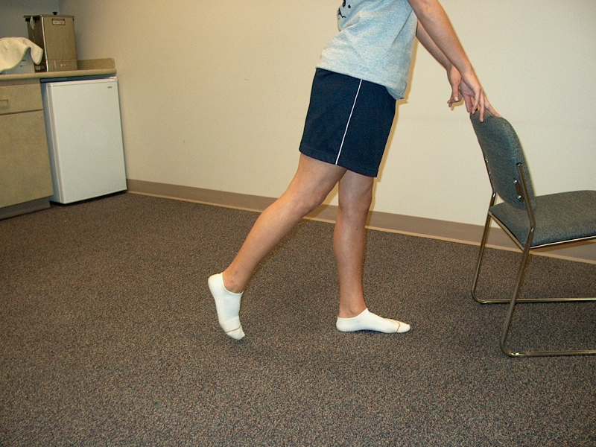
Strengthening: Correct Muscle Imbalances
Glute Strength
While standing on the uninvolved foot and holding on to the back of a chair or counter for support, pull involved leg back while keeping knee straight. Hold 1-2 seconds; lower slowly; repeat.

Slide 26
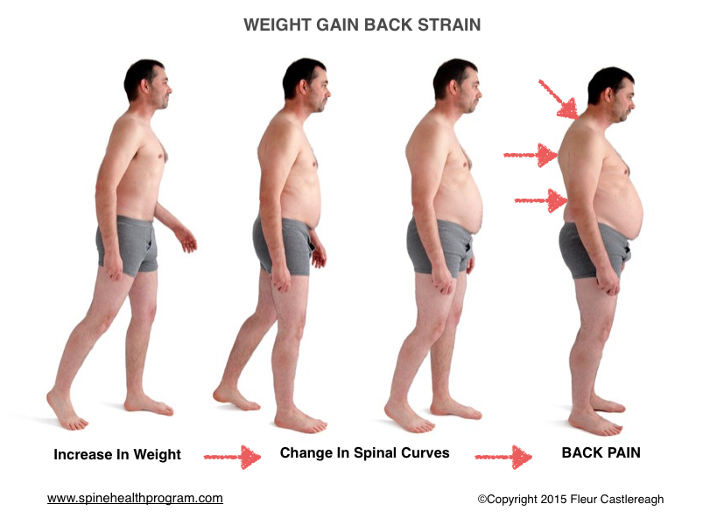
Weight Loss
Only 5% loss needed to reduce pain
No specific fad diet proven
Must Have Caloric Deficit
3200 cal/pound
~75 cal burned for 20 min walk
Avg male burns 2000k cal/day (without exercise)
500 cal/day deficit = 1lb loss/week
1-2lb weight loss/week is safe/healthy

Slide 27
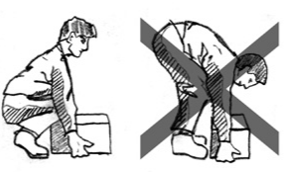
Body Mechanics

Slide 28
Self Treatments
Cold
New injuries < 72 hours
Heat
Old Pain
Alternate Heat/Cold
Massage
Tennis Ball
Tylenol
Aleve
Back Brace
Increase abdominal pressure
Kinesthetic Reminder
Warmth

Slide 29
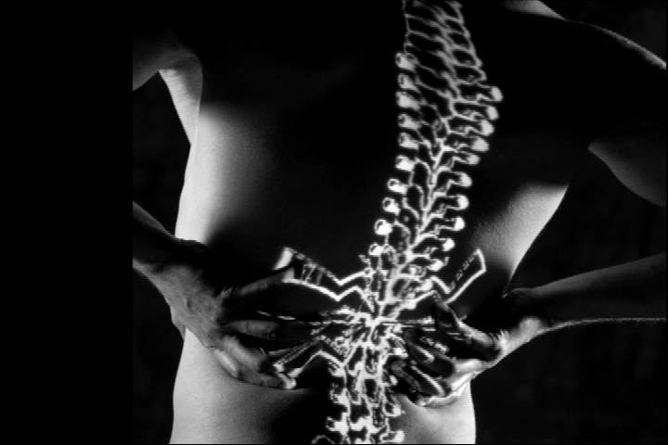
When to see the Doc
Numbness
Weakness
Severe Pain
Incontinence
Fevers, Weight Loss
Pain at night
History of Cancer

Slide 30
What Can be Done?
Physician Assessment

Slide 31
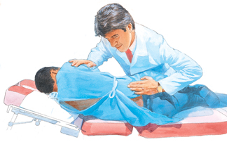
Hands On Assessment
Tenderness
Range of Motion
Strength
Sensation
Reflexes
Asymmetries

Slide 32
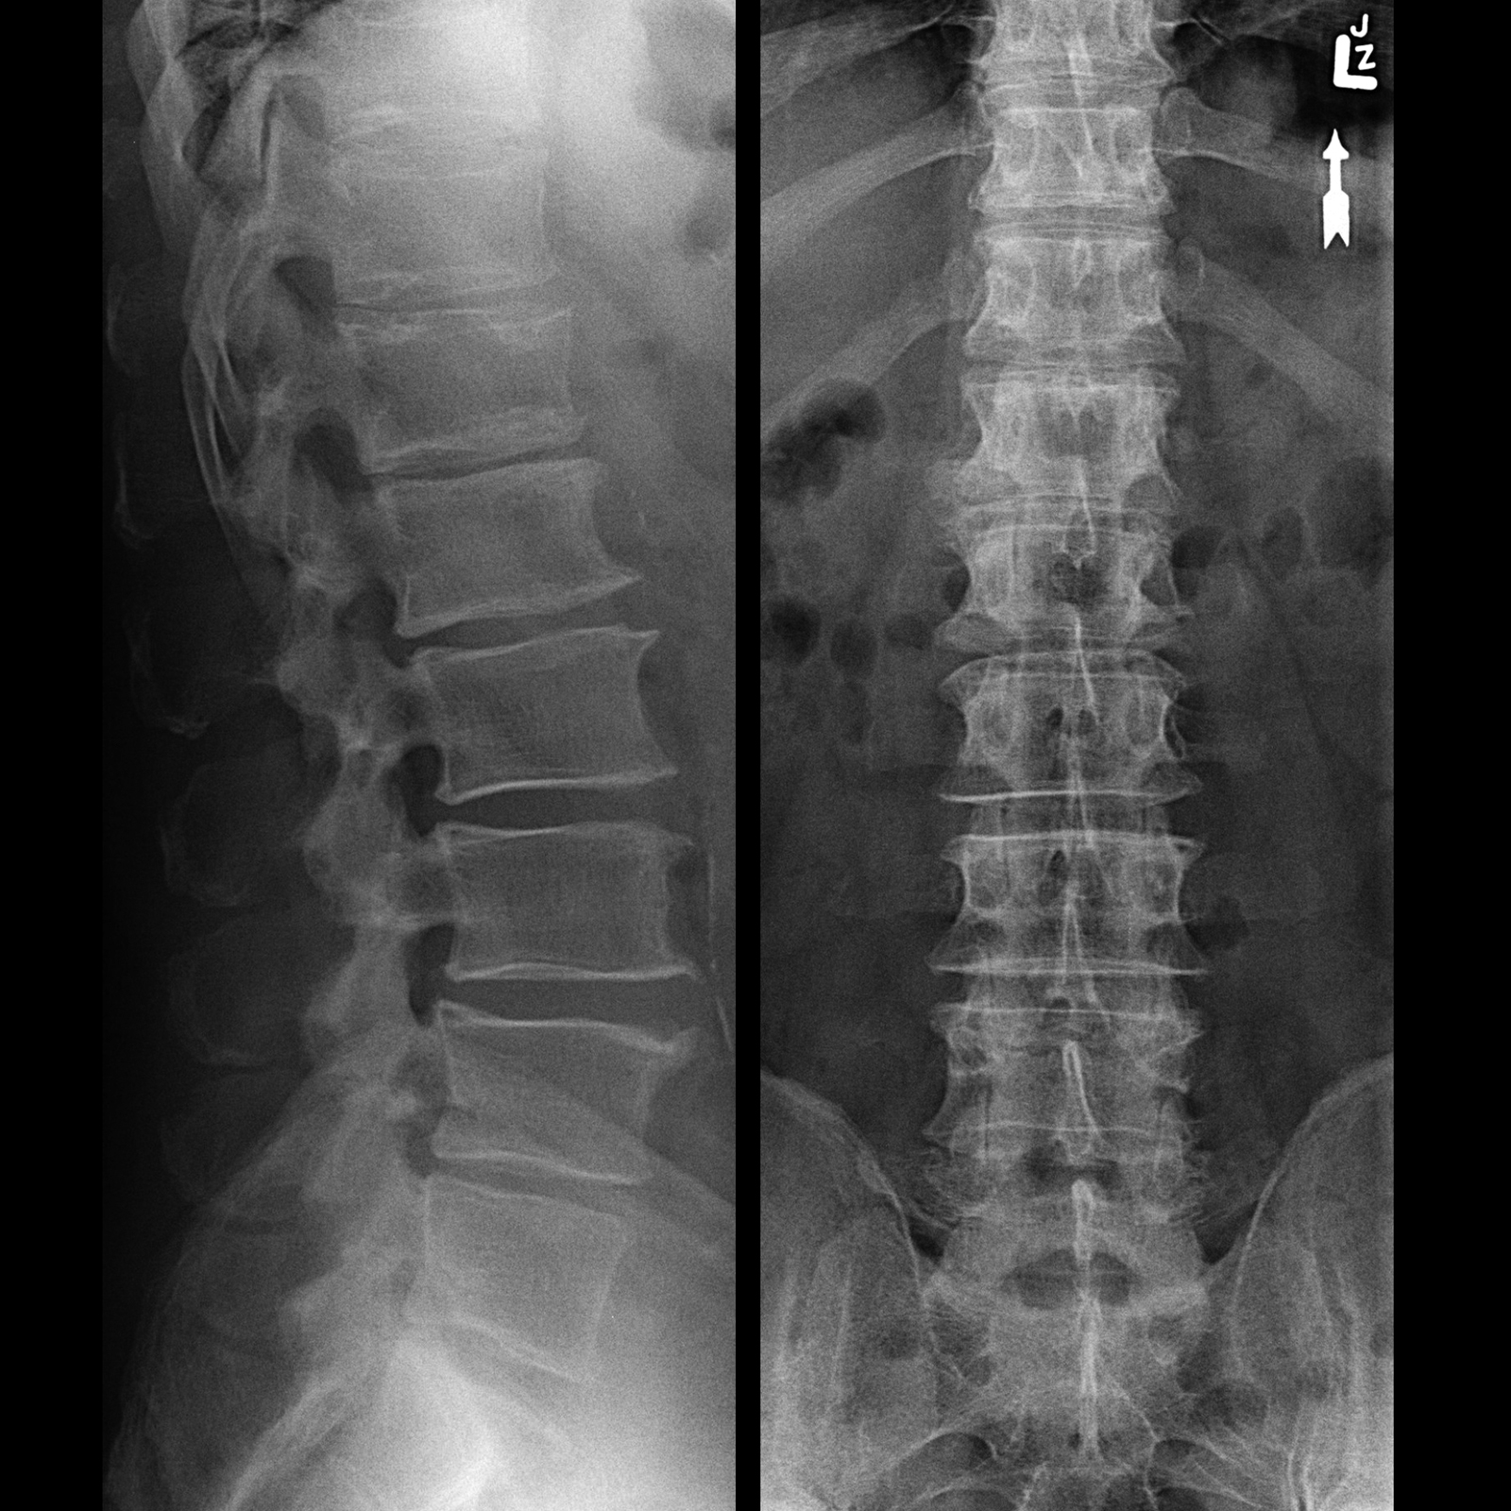
X-Rays
Bones
Shadows
Read between the lines
Dynamic Motion
Notes:
American Academy of Neurology definition

Slide 33
Electrophysiology
Dynamic
Nerve Function
Helps Differentiate Nerve versus Other

Slide 34
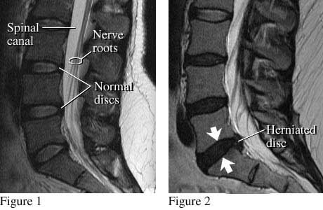
MRI
Detailed Imaging
Static
Procedural Planning

Slide 35
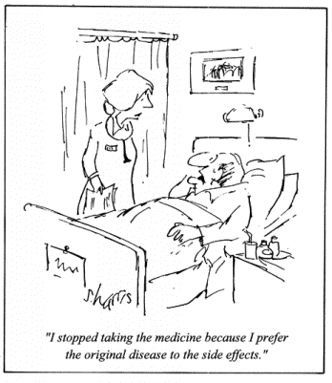
Treatment
Reduce Inflammation
Treat Symptoms
Correct Etiology
Rehabilitation
Surgeries

Slide 36
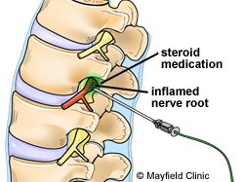
Inflammation
NSAIDs
Cox-II Inhibitors
Steroids
Injectable/Oral
Notes:
10% decrease in stiffness after 30 min ice, however effect lasts less than 1 hour
Deep heating 1.5 watts/cm2 Ultrasound 20% better for increased extensibility with stretching than stretching alone

Slide 37
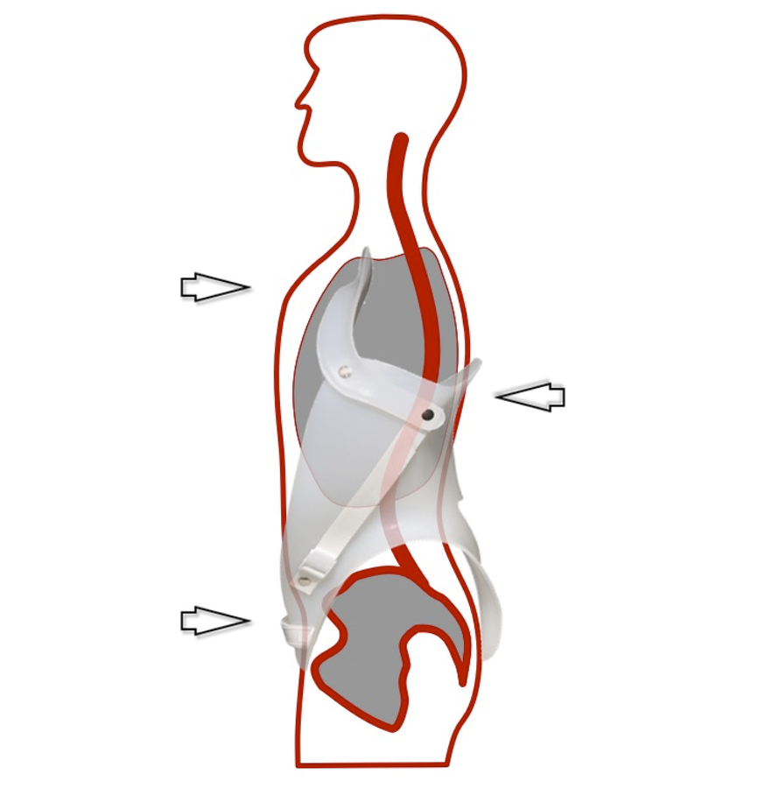
Symptoms
Nerve Pain Meds
Non-Narcotic Pain Meds
Topical Agents
Modalities
Transcutaneous Electrical Stimulation
Orthotics

Slide 38
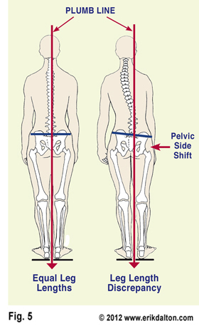
Underlying Problem
Rehabilitation/PT
Orthotics
Leg Length Correction
Injections
Surgeries

Slide 39
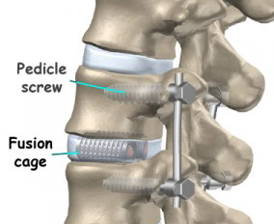
Back Surgery
Pain not relieved by any conservative measures
Incontinence
Weakness
Loss of Quality of Life

Slide 40
Questions?
Office: (830) 315 – 2106
www.hillcountrymuscleandnerve.com

